Slide 1
Introduction to Graph Theory

Slide 2
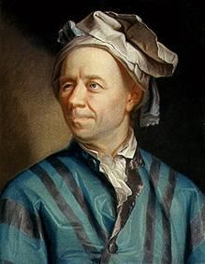
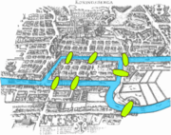
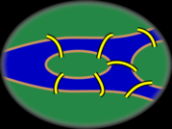
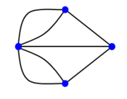
Graph Theory - History
Leonhard Euler's paper on “Seven
Bridges of Königsberg” ,
published in 1736.

Slide 3
Famous problems
“The traveling salesman problem”
A traveling salesman is to visit a number of cities; how to plan the trip so every city is visited once and just once and the whole trip is as short as possible ?

Slide 4
Famous problems
In 1852 Francis Guthrie posed the “four color problem”
which asks if it is possible to color, using only four
colors, any map of countries in such a way as to
prevent two bordering countries from having the same
color.
This problem, which was only solved a century later in
1976 by Kenneth Appel and Wolfgang Haken, can be
considered the birth of graph theory.

Slide 5
Examples
Cost of wiring electronic components
Shortest route between two cities.
Shortest distance between all pairs of cities in a road atlas.
Matching / Resource Allocation
Task scheduling
Visibility / Coverage

Slide 6
Examples
Flow of material
liquid flowing through pipes
current through electrical networks
information through communication networks
parts through an assembly line
In Operating systems to model resource handling (deadlock problems)
In compilers for parsing and optimizing the code.

Slide 7
Basics

Slide 8
What is a Graph?
Informally a graph is a set of nodes joined by a set of lines or arrows.
1
3
1
2
3
2
4
5
6
4
5
6

Slide 9
Definition: Graph
G is an ordered triple G:=(V, E, f)
V is a set of nodes, points, or vertices.
E is a set, whose elements are known as edges or lines.
f is a function
maps each element of E
to an unordered pair of vertices in V.

Slide 10
Definitions
Vertex
Basic Element
Drawn as a node or a dot.
Vertex set of G is usually denoted by V(G), or V
Edge
A set of two elements
Drawn as a line connecting two vertices, called end vertices, or endpoints.
The edge set of G is usually denoted by E(G), or E.

Slide 11
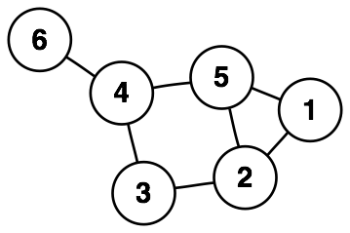
Example
V:={1,2,3,4,5,6}
E:={{1,2},{1,5},{2,3},{2,5},{3,4},{4,5},{4,6}}

Slide 12
Simple Graphs
Simple graphs are graphs without multiple edges
or self-loops.

Slide 13
Path
A path is a sequence of vertices such that there is an edge from each vertex to its successor.
A path is simple if each vertex is distinct.
1
3
A
B
C
2
Cycle
4
5
6
D
E
F
Cycle
Unreachable
Simple path from 1 to 5 = [ 1, 2, 4, 5 ]
Our text’s alternates the vertices and edges.
If there is path p from u to v then we say v is reachable from u via p.

Slide 14
Cycle
A path from a vertex to itself is called a cycle.
A graph is called cyclic if it contains a cycle;
otherwise it is called acyclic
1
3
A
B
C
2
Cycle
4
5
6
D
E
F
Cycle
Unreachable

Slide 15
Connectivity
is connected if
you can get from any node to any other by following a sequence of edges OR
any two nodes are connected by a path.
A directed graph is strongly connected if there is a directed path from any node to any other node.

Slide 16
Sparse/Dense
A graph is sparse if | E | ≈ | V |
A graph is dense if | E | ≈ | V |^{2.}

Slide 17
A weighted graph
is a graph for which each edge has an associated weight, usually given by a weight function w: E → R.
1.2
2
1
2
3
1
2
3
.2
.5
1.5
5
3
.3
1
4
5
6
4
5
6
.5

Slide 18
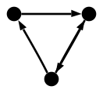
Directed Graph (digraph)
Edges have directions
An edge is an ordered pair of nodes

Slide 19
Bipartite graph
V can be partitioned into 2 sets V₁ and V₂ such that (u,v)∈E implies
either u ∈V₁ and v ∈V₂
OR v ∈V₁ and u∈V_{2.}

Slide 20
Special Types
Empty Graph / Edgeless graph
No edge
Null graph
No nodes
Obviously no edge

Slide 21
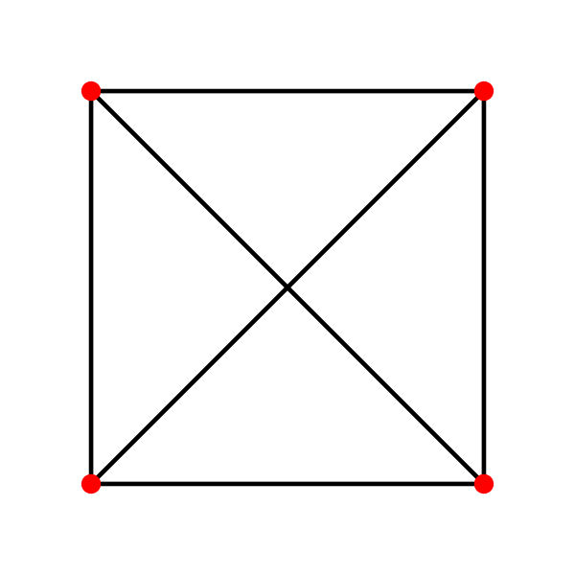

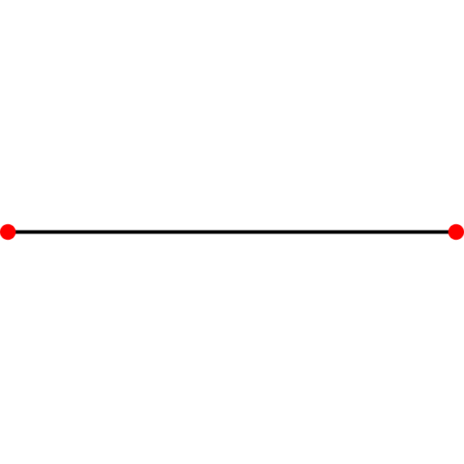
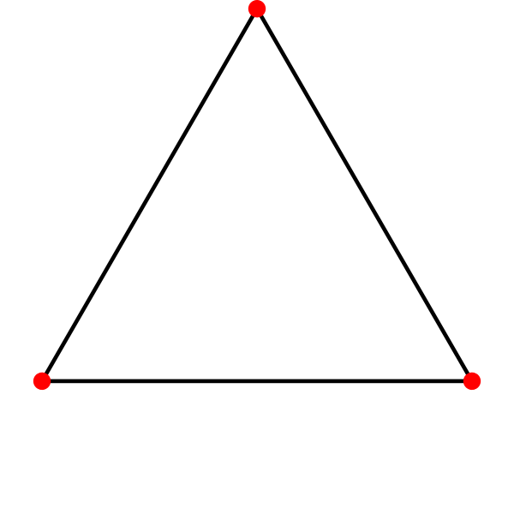
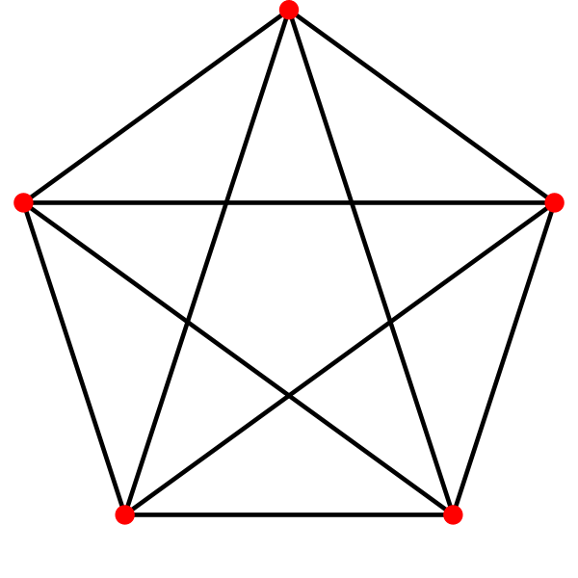
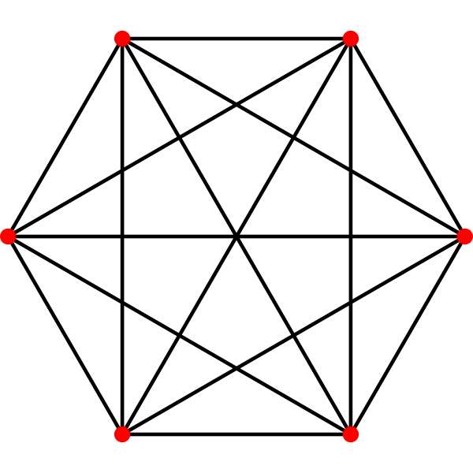
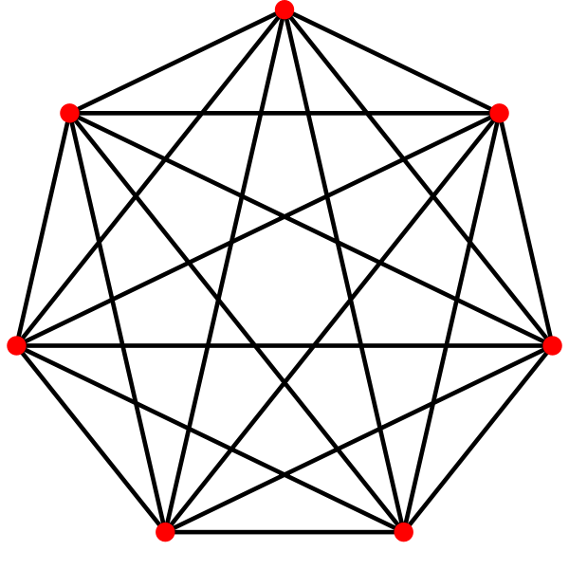
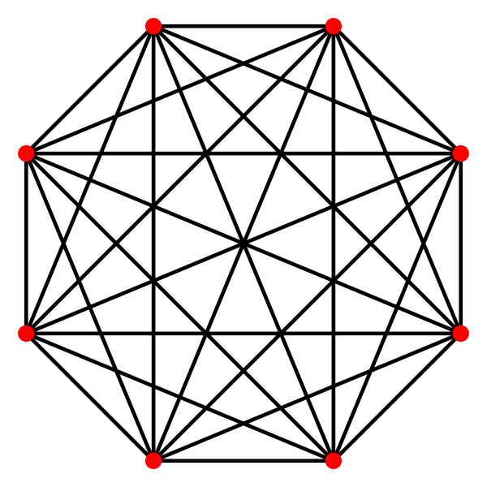
Complete Graph
Denoted K_{n}
Every pair of vertices are adjacent
Has n(n-1) edges

Slide 22
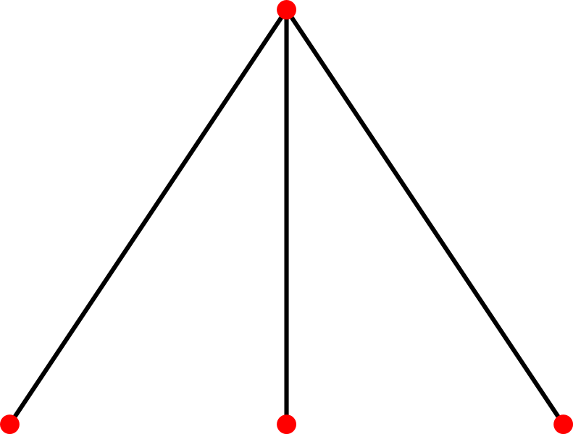
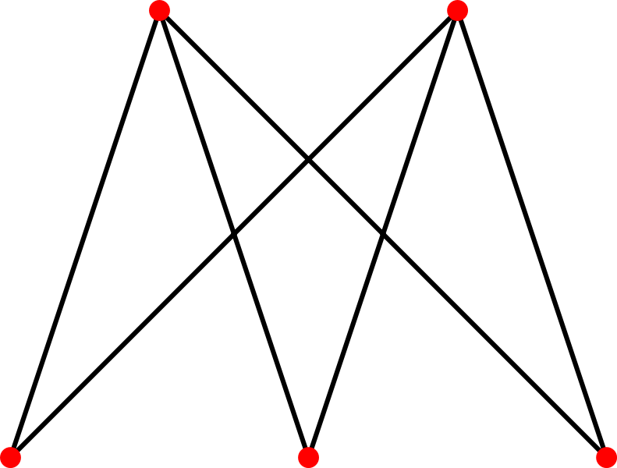
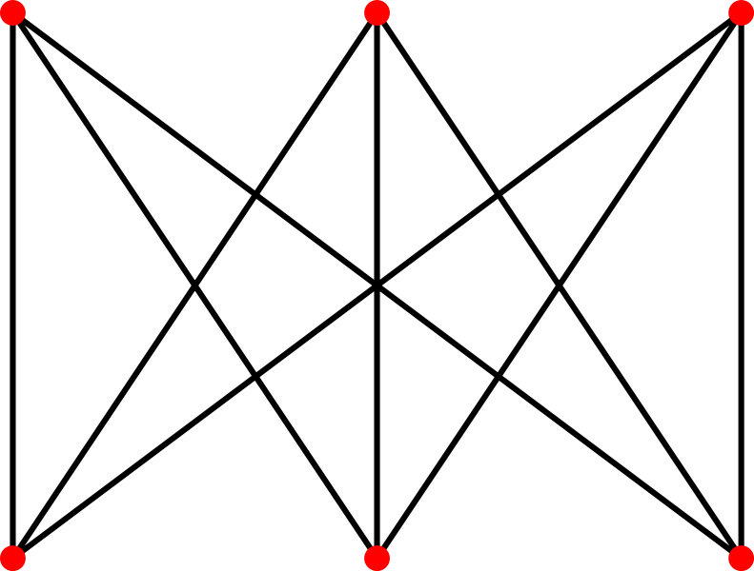
Complete Bipartite Graph
Bipartite Variation of Complete Graph
Every node of one set is connected to every other node on the other set

Slide 23
Planar Graph
Can be drawn on a plane such that no two edges intersect
K₄ is the largest complete graph that is planar

Slide 24
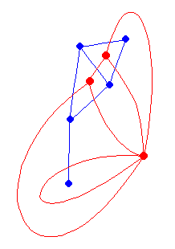
Dual Graph
Faces are considered as nodes
Edges denote face adjacency
Dual of dual is the original graph

Slide 25
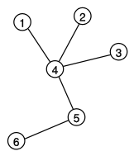
Tree
Connected Acyclic Graph
Two nodes have exactly one path between them

Slide 26
Generalization: Hypergraph
Generalization of a graph,
edges can connect any number of vertices.
Formally, an hypergraph is a pair (X,E) where
X is a set of elements, called nodes or vertices, and
E is a set of subsets of X, called hyperedges.
Hyperedges are arbitrary sets of nodes,
contain an arbitrary number of nodes.

Slide 27
Degree
A
B
C
D
E
F
The degree of B is 2.
Number of edges incident on a node

Slide 28
Degree (Directed Graphs)
1
2
4
5
The in degree of 2 is 2 and the out degree of 2 is 3.
In degree: Number of edges entering
Out degree: Number of edges leaving
Degree = indegree + outdegree

Slide 29
Degree: Simple Facts
If G is a digraph with m edges, then Σ indeg(v) = Σ outdeg(v) = m = |E |
If G is a graph with m edges, then Σ deg(v) = 2m = 2 |E |
Number of Odd degree Nodes is even

Slide 30
Subgraphs

Slide 31
Subgraph
Vertex and edge sets are subsets of those of G
a supergraph of a graph G is a graph that contains G as a subgraph.
A graph G contains another graph H if some subgraph of G
is H or
is isomorphic to H.
H is a proper subgraph if H!=G

Slide 32
Spanning subgraph
Subgraph H has the same vertex set as G.
Possibly not all the edges
“H spans G”.

Slide 33
Induced Subgraph
For any pair of vertices x and y of H, xy is an edge of H if and only if xy is an edge of G.
H has the most edges that appear in G over the same vertex set.

Slide 34
Induced Subgraph (2)
If H is chosen based on a vertex subset S of V(G), then H can be written as G[S]
“induced by S”
A graph that does not contain H as an induced subgraph is said to be H-free

Slide 35
Component
Maximum Connected sub graph

Slide 36
Isomorphism

Slide 37
Isomorphism
Bijection, i.e., a one-to-one mapping:
f : V(G) -> V(H)
u and v from G are adjacent if and only if f(u) and f(v) are adjacent in H.
If an isomorphism can be constructed between two graphs, then we say those graphs are isomorphic.

Slide 38

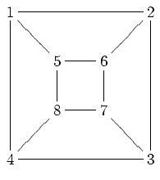
Isomorphism Problem
Determining whether two graphs are isomorphic
Although these graphs look very different, they are isomorphic; one isomorphism between them is
f(a) = 1 f(b) = 6 f(c) = 8 f(d) = 3
f(g) = 5 f(h) = 2 f(i) = 4 f(j) = 7

Slide 39
Graph Abstract Data Type

Slide 40
Graph ADT
In computer science, a graph is an abstract data type (ADT)
that consists of
a set of nodes and
a set of edges
establish relationships (connections) between the nodes.
The graph ADT follows directly from the graph concept from mathematics.

Slide 41
Representation (Matrix)
Incidence Matrix
E x V
[edge, vertex] contains the edge's data
Adjacency Matrix
V x V
Boolean values (adjacent or not)
Or Edge Weights

Slide 42
Representation (List)
Edge List
pairs (ordered if directed) of vertices
Optionally weight and other data
Adjacency List

Slide 43
Implementation of a Graph.
Adjacency-list representation
an array of |V | lists, one for each vertex in V.
For each u ∈ V , ADJ [ u ] points to all its adjacent vertices.

Slide 44
Adjacency-list representation for a directed graph.
1
2
5
1
2
2
5
3
4
3
3
4
5
4
4
5
5
5
Variation: Can keep a second list of edges coming into a vertex.

Slide 45
Adjacency lists
Advantage:
Saves space for sparse graphs. Most graphs are sparse.
Traverse all the edges that start at v, in θ(degree(v))
Disadvantage:
Check for existence of an edge (v, u) in worst case time θ(degree(v))

Slide 46
Adjacency List
Storage
For a directed graph the number of items are Σ(out-degree (v)) = | E |
So we need Θ( V + E )
For undirected graph the number of items are Σ(degree (v)) = 2 | E | Also Θ( V + E )
Easy to modify to handle weighted graphs. How?
v ∈ V
v ∈ V

Slide 47
Adjacency matrix representation
1
2
1 2 3 4 5
3
1
2
3
4
5
0 1 0 0 1
5
4
1 0 1 1 1
0 1 0 1 0
0 1 1 0 1
1 1 0 1 0
|V | x |V | matrix A = ( a_{ij} ) such that a_{ij} = 1 if (i, j ) ∈E and 0 otherwise. We arbitrarily uniquely assign the numbers 1, 2, . . . , | V | to each vertex.

Slide 48
Adjacency Matrix Representation for a Directed Graph
1 2 3 4 5
1
2
3
4
5
0 1 0 0 1
1
2
0 0 1 1 1
0 0 0 1 0
3
0 0 0 0 1
5
4
0 0 0 0 0

Slide 49
Adjacency Matrix Representation
Advantage:
Saves space for:
Dense graphs.
Small unweighted graphs using 1 bit per edge.
Check for existence of an edge in θ(1)
Disadvantage:
Traverse all the edges that start at v, in θ(|V|)

Slide 50
Adjacency Matrix Representation
Storage
Θ( | V |²) ( We usually just write, Θ( V ²) )
For undirected graphs you can save storage (only 1/2(V²)) by noticing the adjacency matrix of an undirected graph is symmetric. How?
Easy to handle weighted graphs. How?

Slide 51
Graph Algorithms

Slide 52
Graph Algorithms
Shortest Path
Single Source
All pairs (Ex. Floyd Warshall)
Network Flow
Matching
Bipartite
Weighted
Topological Ordering
Strongly Connected

Slide 53
Graph Algorithms
Biconnected Component / Articulation Point
Bridge
Graph Coloring
Euler Tour
Hamiltonian Tour
Clique
Isomorphism
Edge Cover
Vertex Cover
Visibility

Slide 54
Thank you

